Slide 1

AI-Enhanced Personalized Healing Environments
Using Ayurvedic Principles
Prakriti Ayursensora — Smart Aroma & Healing Environment System
Submitted by:
Dr. Krantee M. Jamdaade | Dr. Harshali Y. Patil | Dr. Ninad D. Mehendale
KJSIM | SSBAS | KJSSE
Notes:
Slide2: https://www.youtube.com/watch?v=JL_grPUnXzY

Slide 2
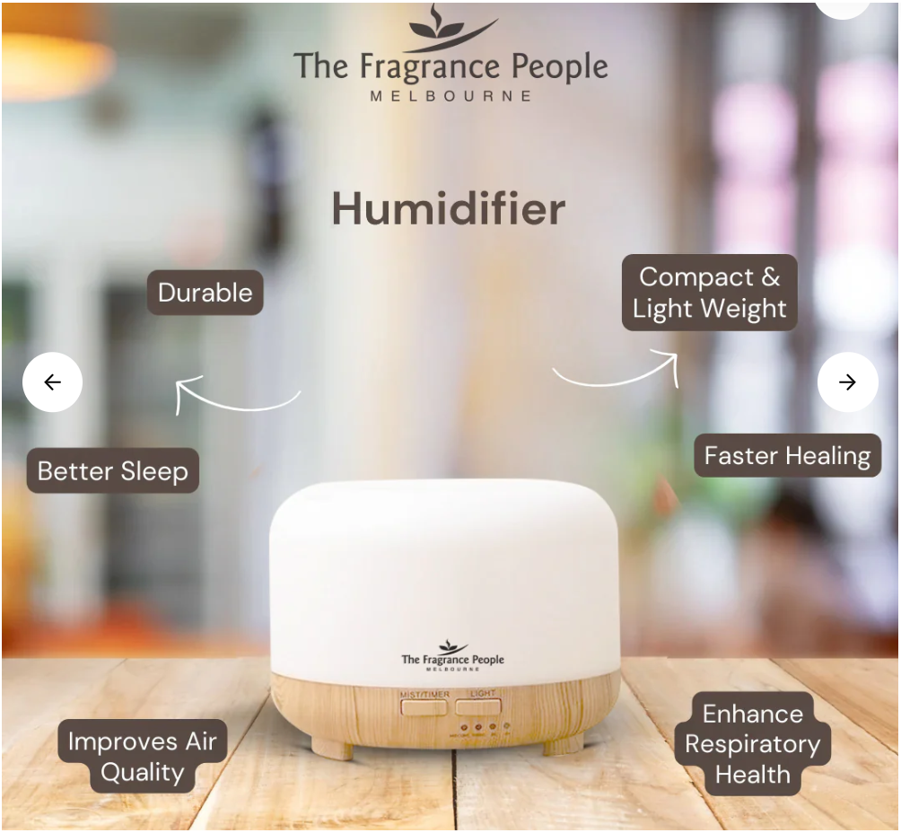
Idea :
Deluxe and Premium Hospital Wards
Perfume dispensers
Projector to project scenery
On/Off Button
Thumb/Index finger punching (For collecting traits already captured through Mobile App)
₹​ 2,999.00
Note: Camera can be replaced by Mobile App
Notes:
https://www.thefragrancepeople.com/products/aroma-mist-diffuser-500ml-with-remote?variant=45535317295328&country=IN&currency=INR&utm_medium=product_sync&utm_source=google&utm_content=sag_organic&utm_campaign=sag_organic&gad_source=1&gclid=CjwKCAiA3ZC6BhBaEiwAeqfvyj86468E4JdatlJXOR3n2aOLqTjcOSOI50qX-BU73FCH4dsj305hsxoCGLwQAvD_BwE

Slide 3




Target User Segments
Wellness Centres
Hospital’s Deluxe Rooms
Spas & Hotels
Doctor’s Cabins
CEO/CFO/CTO
Directors
Senior Executives
Notes:
It is not only designed to help patients heal, but also to improve wellness and reduce stress for executives working in private cabins and stressful work environments.
This expands its use from healthcare to corporate wellness

Slide 4





Indigenous Knowledge
Earth
Water
Potential Energy
(Kaphaj)
Physical
Physiological
Relationship between Tri-Dosha and Five Elements
Psychological
Prakriti
Little water
Air
Thermal Energy (Pittaj)
Kinetic Energy
(Vataj)
Fire
Ether
Notes:
Basically, the objective of this paper is to apply today’s modern Predictive Machine Learning Algorithms to the Ancient Study mentioned in the Charak Sanhita which is referred by the Ayurvdic Physicians to Prescribe Ayurveda Medicine.
What Charak Sanhita says is?
At time of conception of a baby inside the womb of a mother.. The Prakriti is decided based on the Prakriti of mother & father.
This Prakriti is of three types Kaphaj, Vataj & Pittaj and
Kaphaj, is made up of Water & Earth
Vataj, , is made up of little Water & Fire
Pittaj , is made up of Air & Ether

Slide 5
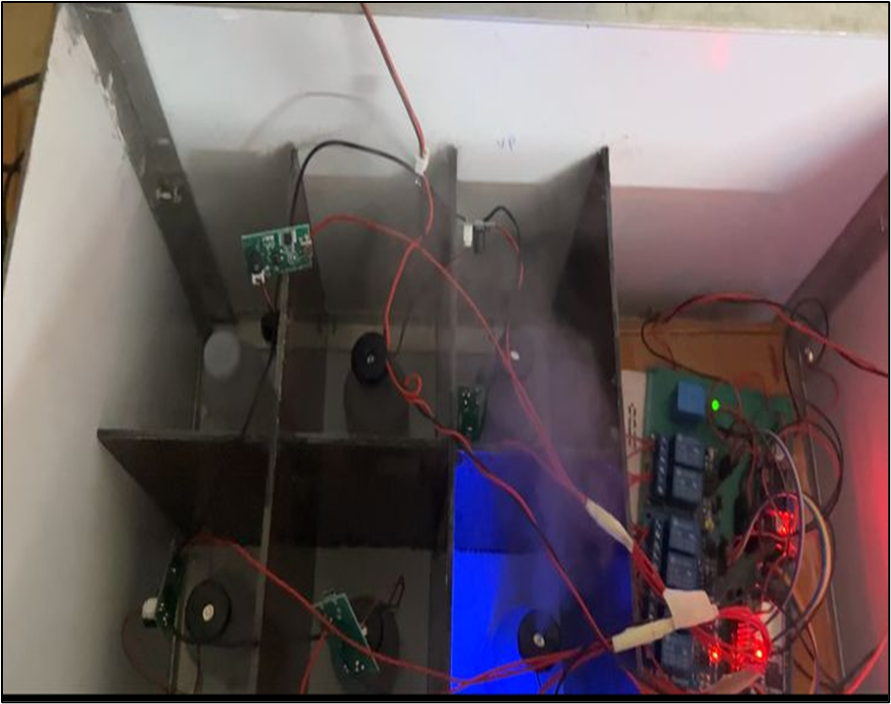
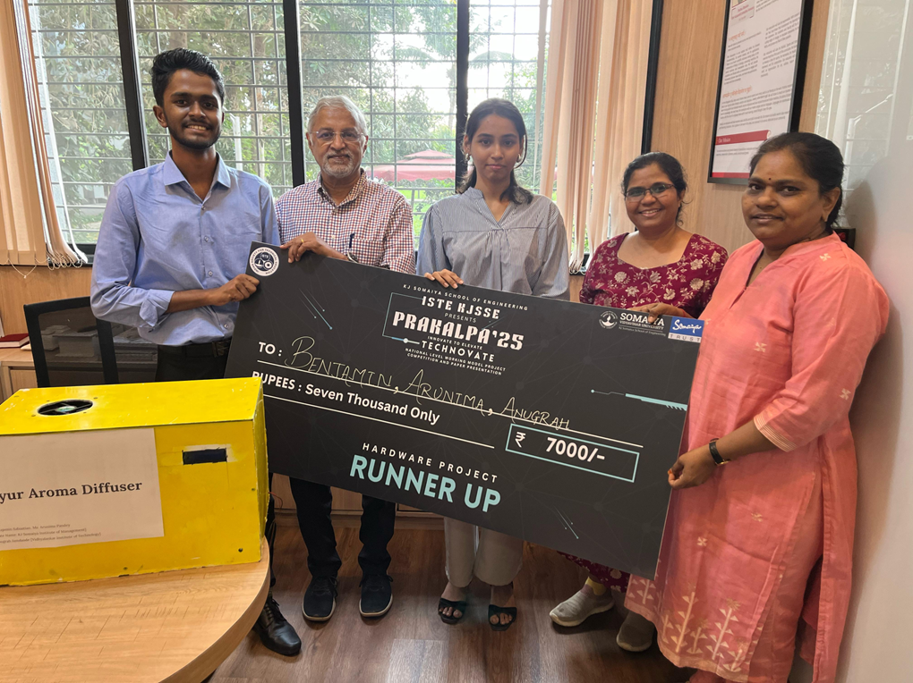
3 Modules
1. Aroma therapy
Kaphaj- Rosemery/ Eucalyptus / Thyme / Peppermint
Pittaj – Rose/ Jasmin / Lavender / Mint
Vataj – Sandal Wood/ Cinnamon/frankincense
3. Music Melody
2. Display Technology
Kaphaj – Bhairav, Jaunpuri, Hamsadhwani, Desh
Kaphaj- Flowing water, Medows
Pittaj – Miyan ki Todi, Malkauns, Marwa, Durga
Pittaj – Mountains + Water bodies
Vataj – Bhimpalasi, Bageshree, Yaman, Kafi
Vataj – Lush Forest
Notes:
Display Technology: An advanced display could simulate natural environments (forests, beaches, mountains) that change based on the user's dosha and current needs.
Aromatherapy: An optional feature could release appropriate essential oils during the workout (e.g., calming lavender for Vata, cooling peppermint for Pitta, or invigorating eucalyptus for Kapha).
Aroma

Slide 6
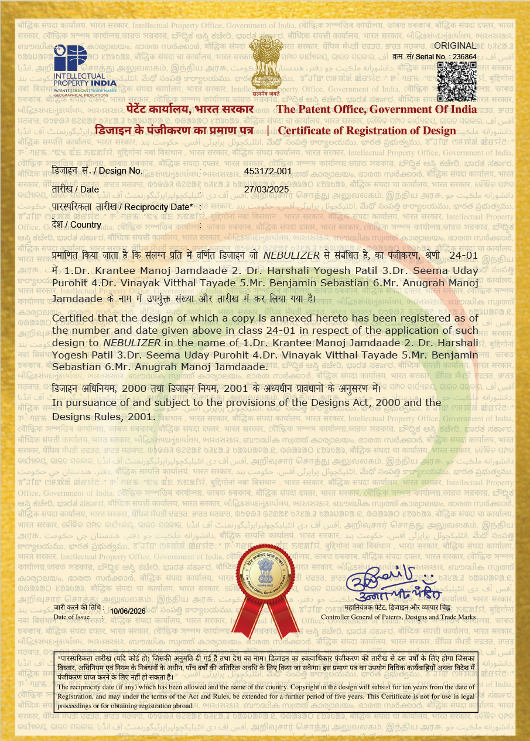
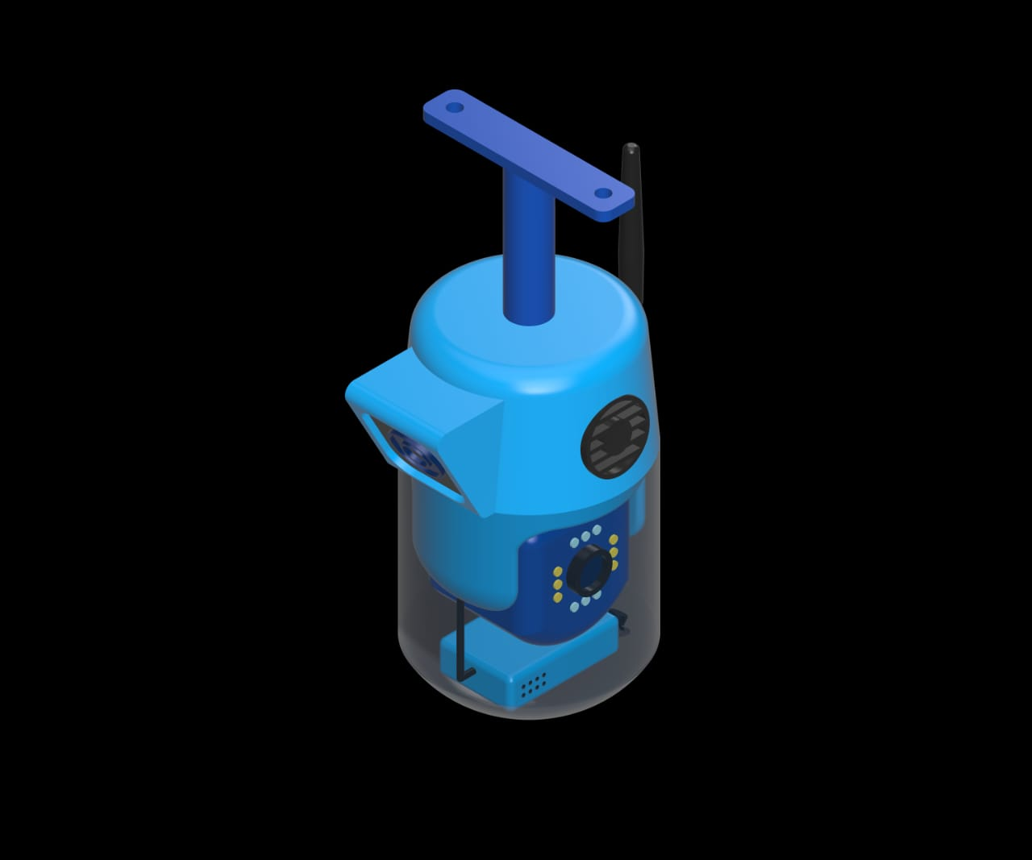
PRAKRITI AYURSENSORA-AI NEBULIZER
Design Registered
Design Certificate

Slide 7
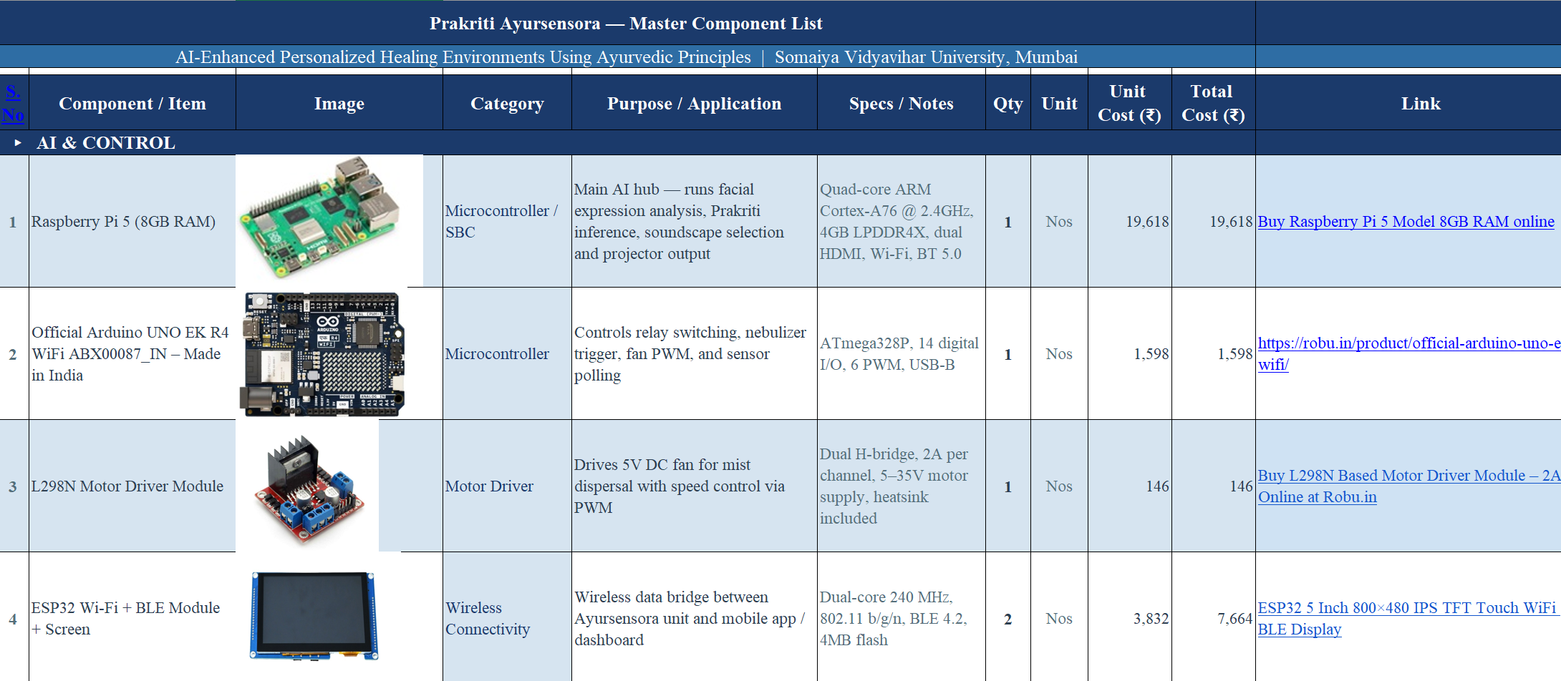
Ayursensora Master Component List
6

Slide 8
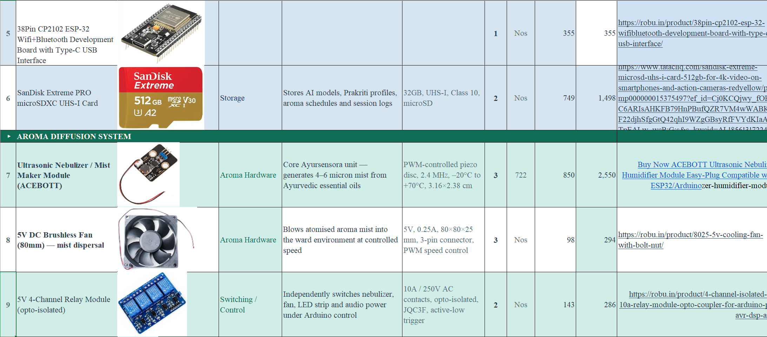
Ayursensora Master Component List
7

Slide 9
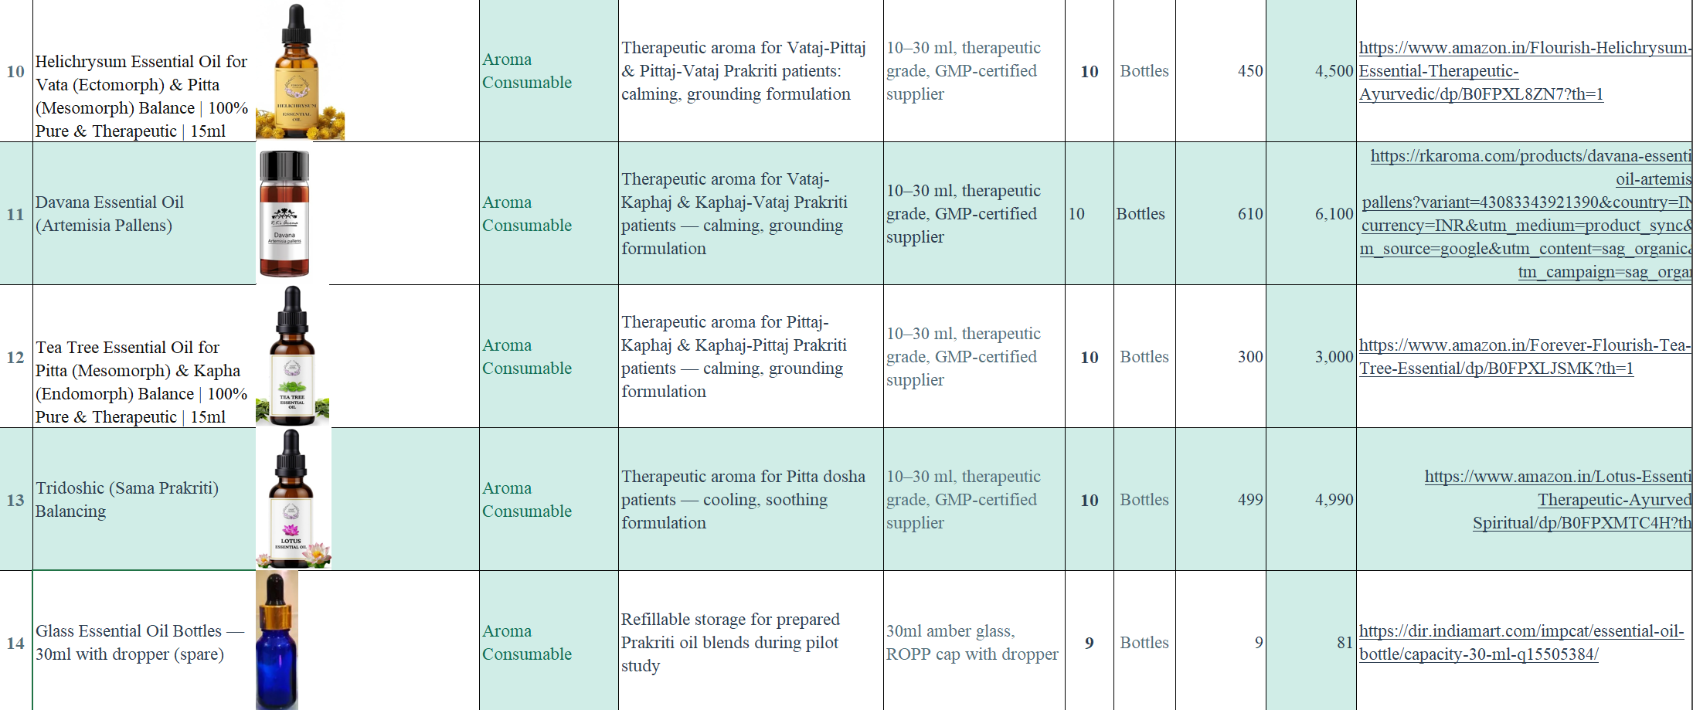
Ayursensora Master Component List
8

Slide 10
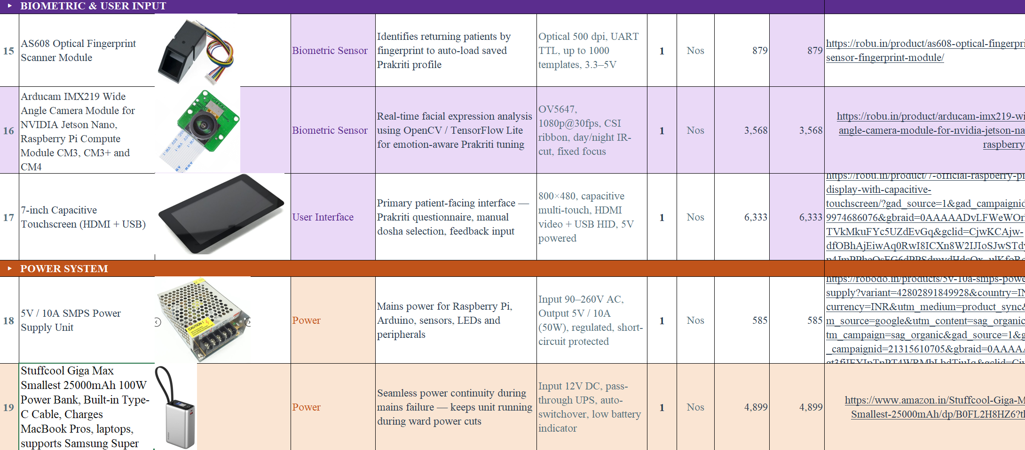
Ayursensora Master Component List
9

Slide 11
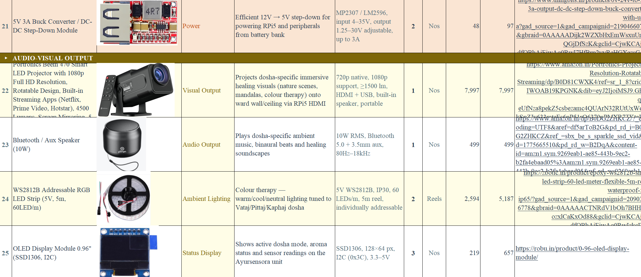
Ayursensora Master Component List
10

Slide 12
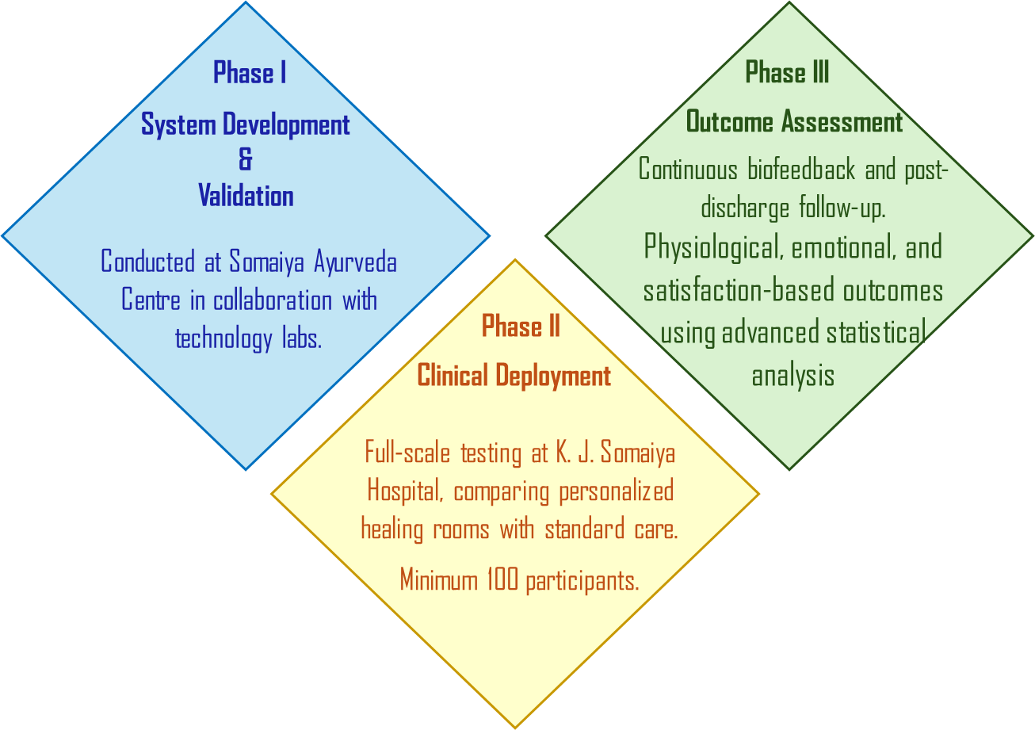
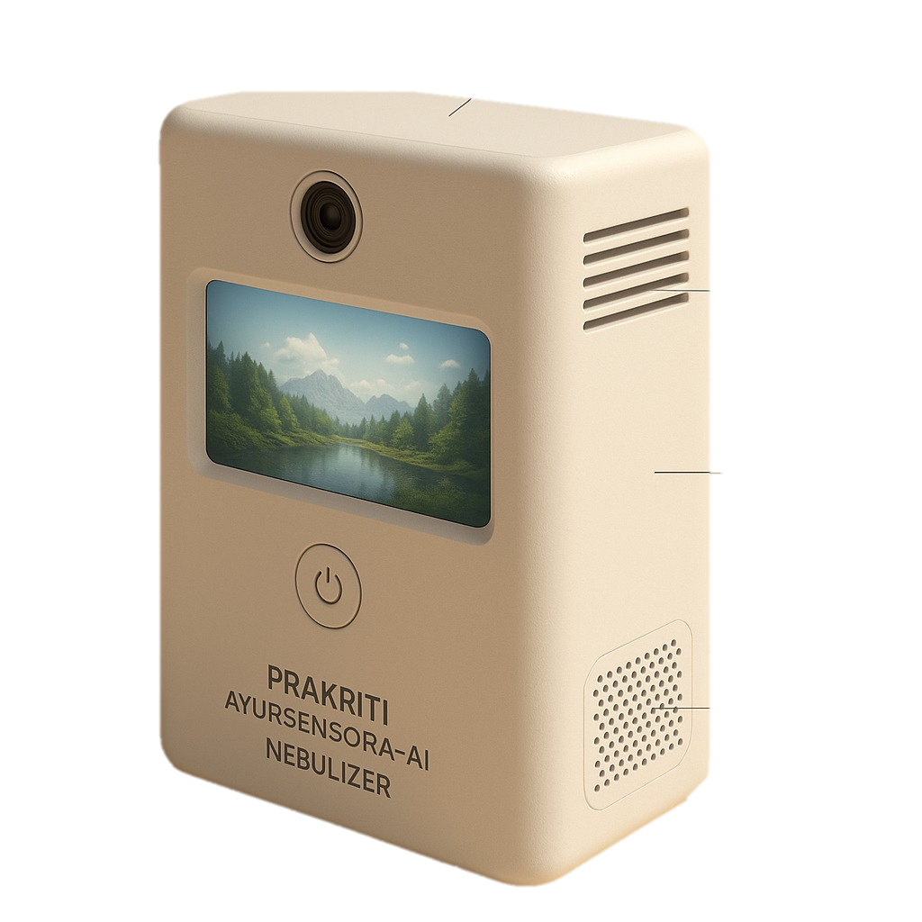
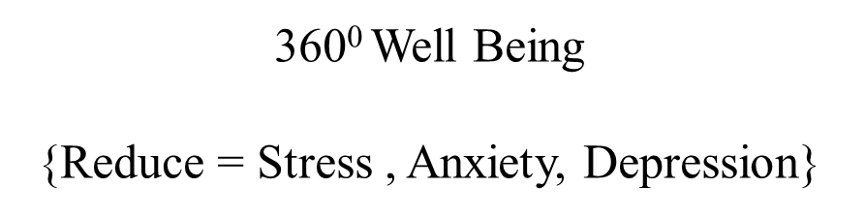
Methodology
Music Melody
Kaphaj – Bhairav, Jaunpuri, Hamsadhwani, Desh
Pittaj – Miyan ki Todi, Malkauns, Marwa, Durga
Vataj – Bhimpalasi, Bageshree, Yaman, Kafi
Aroma therapy
Kaphaj- Rosemery/ Eucalyptus / Thyme / Peppermint
Pittaj – Rose/ Jasmin / Lavender / Mint
Vataj – Sandal Wood/ Cinnamon/frankincense
Display Technology
Kaphaj- Flowing water, Medows
Pittaj – Mountains + Water bodies
Vataj – Lush Forest
Proposed Design
Notes:
2. What are the major objectives of the proposal?
Answer:
The objectives include:
Developing real-time Prakriti assessment using biofeedback and wearable sensors.
Evaluating the efficacy of dosha-specific aromatherapy.
Designing a personalized environment with music, aroma, and visuals.
Dynamically adapting the environment based on real-time patient data (e.g., heart rate variability).
Assessing impact on emotional regulation, recovery, and satisfaction

Slide 13
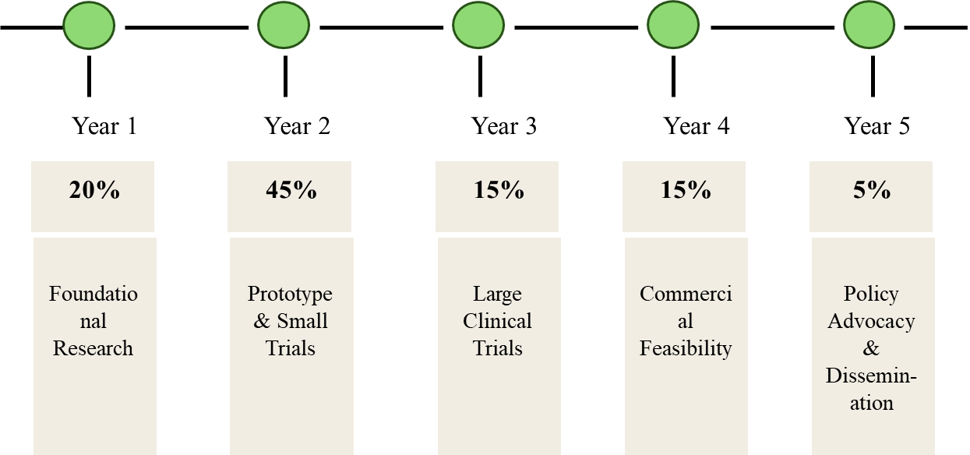
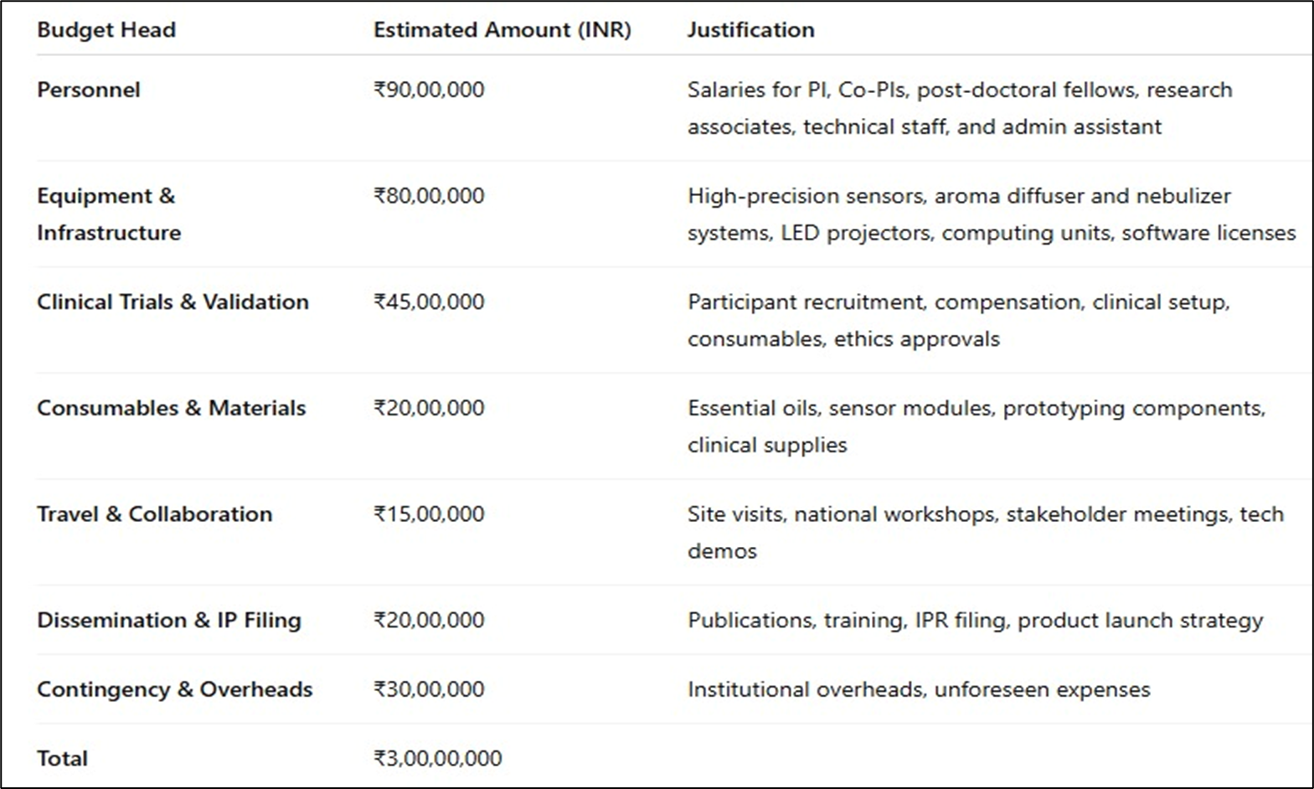

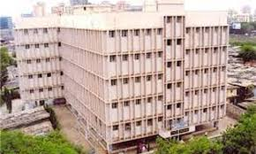
Project Timeline
Budget
Institutional Support
Current Status
KG Mittal Ayurvedic Hospital
Notes:
2. What are the major objectives of the proposal?
Answer:
The objectives include:
Developing real-time Prakriti assessment using biofeedback and wearable sensors.
Evaluating the efficacy of dosha-specific aromatherapy.
Designing a personalized environment with music, aroma, and visuals.
Dynamically adapting the environment based on real-time patient data (e.g., heart rate variability).
Assessing impact on emotional regulation, recovery, and satisfaction

Slide 14
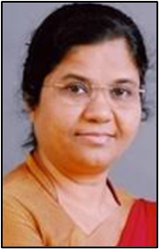
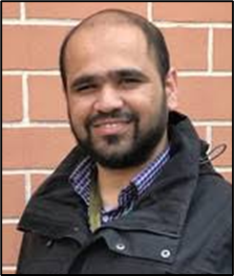
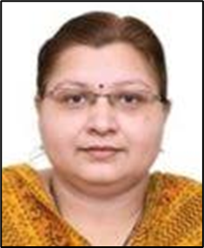
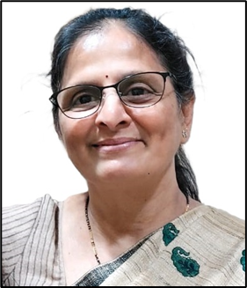

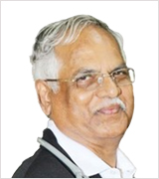
Our Team
Role: Overall project preparation, administration and coordination. Ayurveda principles, Oversees timeline management, milestone tracking, and ICSSR compliance.Coordinates between the Somaiya Ayurveda Centre and K. J. Somaiya Hospital for participant recruitment and implementation.
Role: Technical & AI System Lead responsible for the design and implementation of AI-based Prakriti assessment engine. Sensor integration and real-time feedback system. Supervises the development of the hardware prototype, control algorithms, and adaptive system logic.
Krantee
Ninad
Role: Technical Development & Integration System Lead Responsible for interdisciplinary integration across Ayurveda, AI, psychology, and clinical operations. Oversees Machine Learning, Data Analysis & Dashboard Design
Role: Clinical Trials & Psychological Assessment Lead who Designs the clinical trial protocols, including: Participant inclusion/exclusion criteria. Ethical approvals and patient consent workflows. Oversees psychological data collection (PSS, HADS, PSQI).
Harshali
Seema
Role: International Public Health and Evaluation Expert who will lead on:Outcome measurement protocols and evidence validation. Ensuring international standards for clinical trials and publication ethics.Brings expertise in global healthcare systems, helping align project outcomes for future WHO or NHS integration.
Role: Ayurveda and Prakriti Expert who Provides Ayurvedic expertise in: Validating Prakriti models. Mapping essential oils, ragas, and visual elements to dosha types (Vata, Pitta, Kapha). Assists in developing standardized Prakriti questionnaires and Ayurvedic training for other team members.
Om
Vinayak
Notes:
Good Afternoon!
I’m glad to present our interdisciplinary project on AI-enhanced, Ayurveda-based healing environments—where Modern Technology meets Ancient Wisdom for modern healthcare.

Slide 15





Thank You
simsr.somaiya.edu
Notes:
Slide2: https://www.youtube.com/watch?v=JL_grPUnXzY

Slide 16
